Slide 1
Morphology And Finite-State Transducers

Slide 2
Table of Content
Inflectional Morphology and Derivational Morphology
Finite-State Morphological Parsing
The Lexicon and Morphotactics
Morphological Parsing with Finite-State Transducers
Combining FST Lexicon and Rules- Lexicon-free FSTs
The Porter Stemmer- Human Morphological Processing- Speech Sounds
Phonetic Transcription- The Phoneme and Phonological Rules.

Slide 3
Morphology
Morphological analysis is a field of linguistics that studies the structure of words.
It identifies how a word is produced through the use of morphemes (basic key word).
A morpheme is a basic unit of the English language. The morpheme is the smallest element of a word that has grammatical function and meaning.
Free morpheme and bound morpheme are the two types of morphemes. A single free morpheme can become a complete word.
For instance, a bus, a bicycle, and so forth.
A bound morpheme, on the other hand, cannot stand alone and must be joined to a free morpheme to produce a word. ing, un, and other bound morphemes are examples.

Slide 4
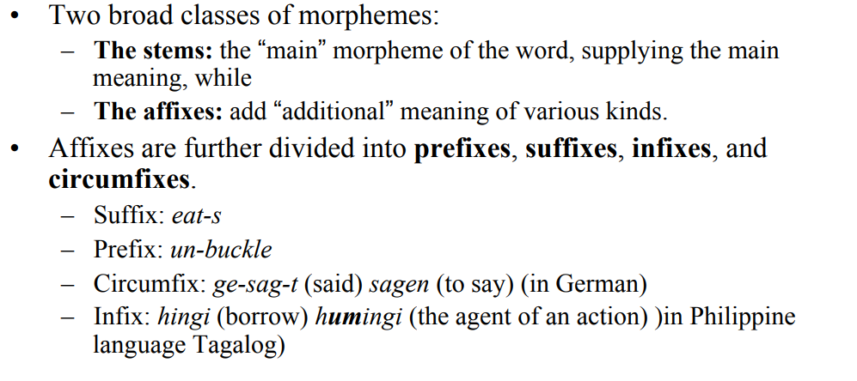
Morphology

Slide 5
Types of Morphology
Inflectional Morphology
Derivational Morphology

Slide 6
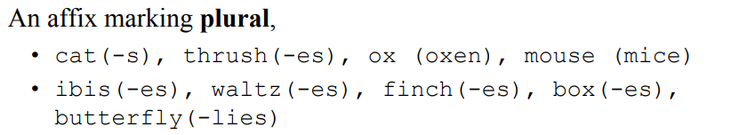
Inflectional Morphology
Represents modification of a word to express different grammatical categories.
Inflectional morphology is the study of processes, including affixation and vowel change, that distinguish word forms in certain grammatical categories.
Inflectional morphology consists of at least five categories, provided in the following excerpt from Language Typology and Syntactic Description: Grammatical Categories and the Lexicon.
As the text will explain, derivational morphology cannot be so easily categorized because derivation isn’t as predictable as inflection. Examples- cats, men etc.

Slide 7
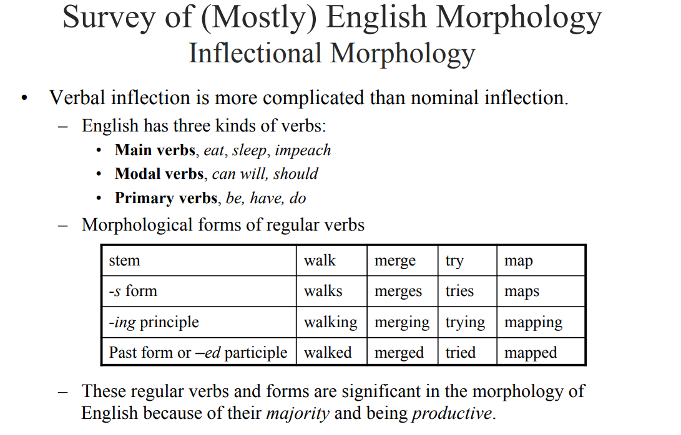
Inflectional Morphology

Slide 8
Derivational Morphology
Derivation Morphology may be distinguished from inflectional morphology, which typically does not change category but rather modifies lexemes to fit into various syntactic contexts.
Inflection typically expresses distinctions like number, case, tense, aspect, person, among others. On the other hand, derivation may be distinguished from compounding, which also creates new lexemes, but by combining two or more bases rather than by affixation, reduplication, subtraction, or internal modification of various sorts.
Although the distinctions are generally useful, in practice applying them is not always easy.

Slide 9
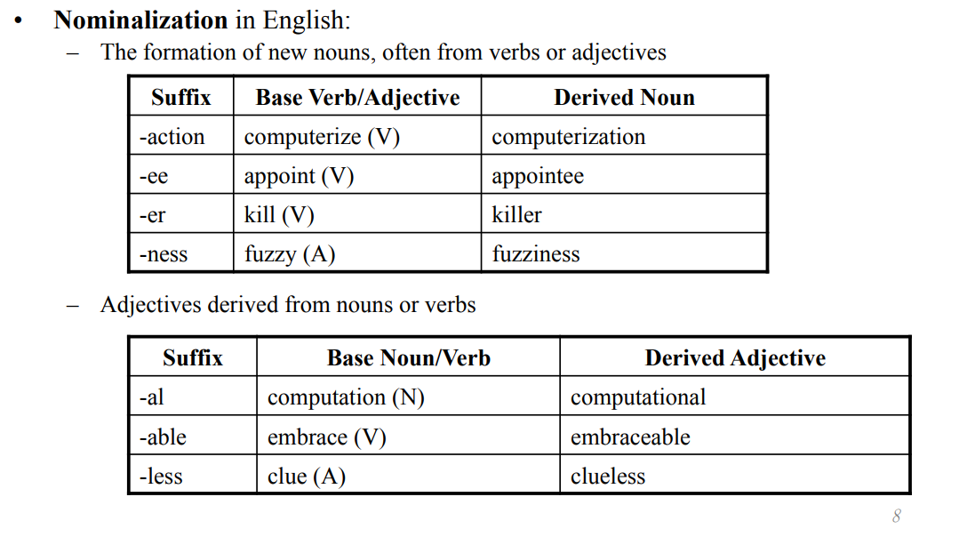
Derivational Morphology
Examples:

Slide 10
Derivational Morphology
Examples:

Slide 11
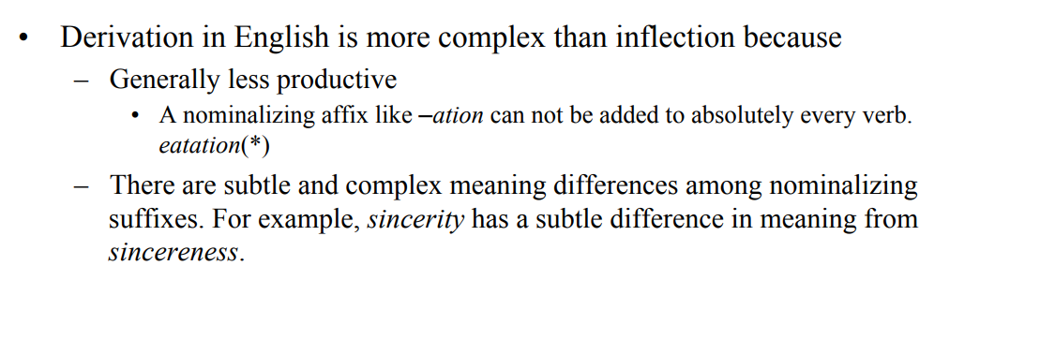
Limitations of Derivational Morphology

Slide 12
Finite-State Morphological Parsing
Morphological parsing, in natural language processing, is the process of determining the morphemes from which a given word is constructed.
It must be able to distinguish between orthographic rules and morphological rules. For example, the word 'foxes' can be decomposed into 'fox' (the stem), and 'es' (a suffix indicating plurality).
The generally accepted approach to morphological parsing is through the use of a finite state transducer (FST), which inputs words and outputs their stem and modifiers.
The FST is initially created through algorithmic parsing of some word source, such as a dictionary, complete with modifier markups.

Slide 13
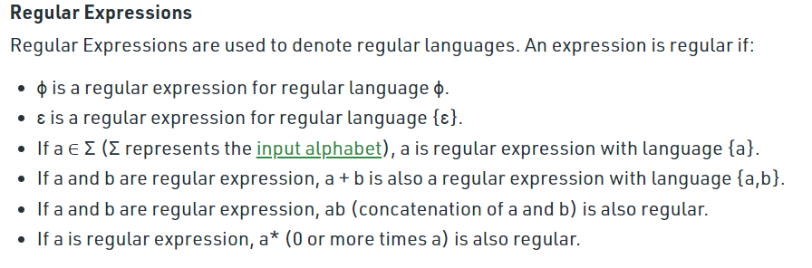
Finite State Transducers
An important concept of Regular Machines or a computing model that deal with regular languages.
As discussed in Chomsky Hierarchy, Regular Languages are the most restricted types of languages and are accepted by finite automata.

Slide 14
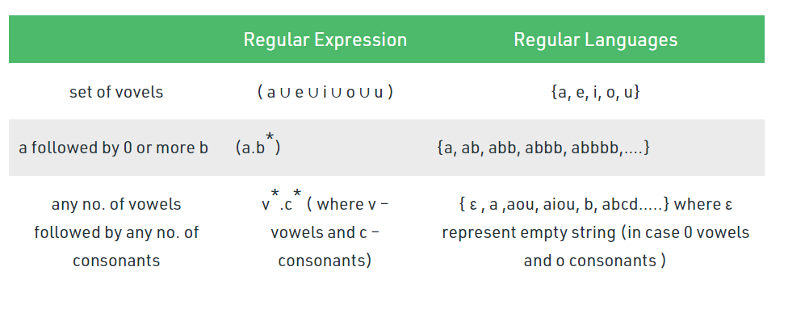
Regular languages/ Expressions

Slide 15
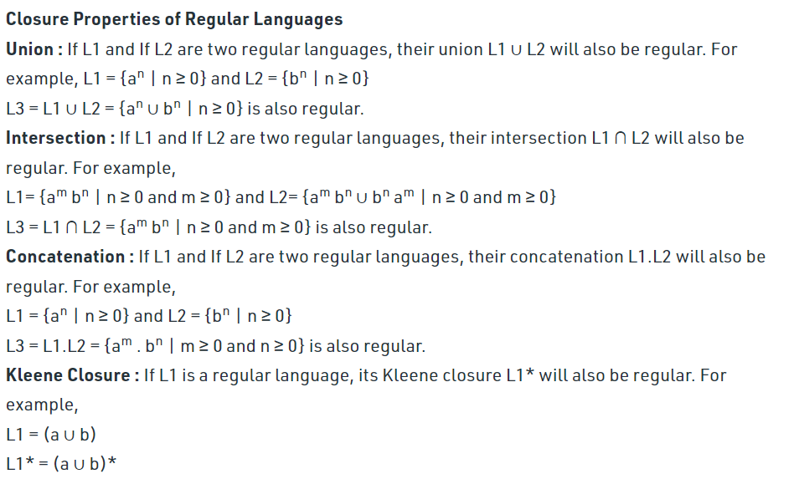
Regular languages/ Expressions (Properties)

Slide 16
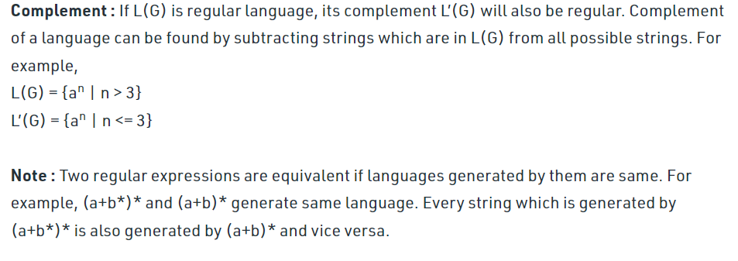
Regular languages/ Expressions (Properties)

Slide 17
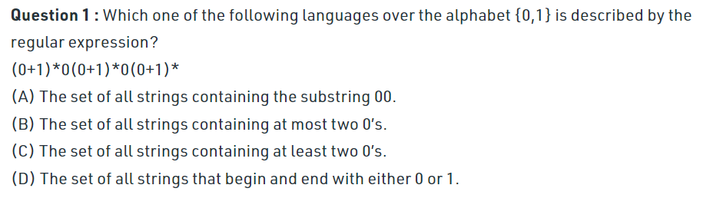
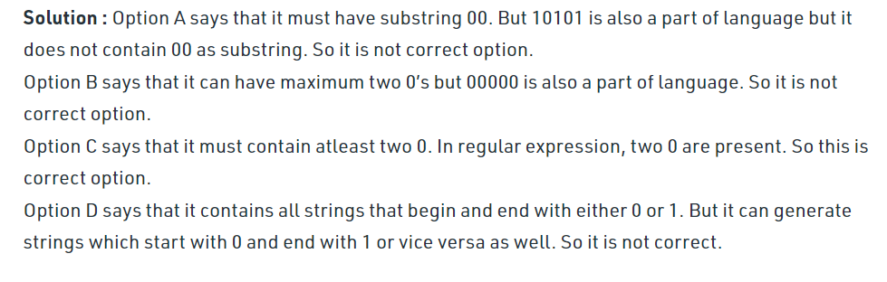
Regular languages/ Expressions (Exercise)

Slide 18
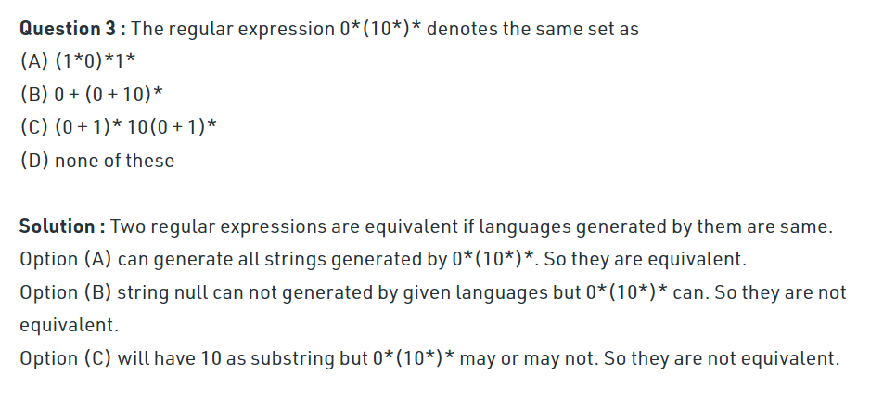
Regular languages/ Expressions (Excercise)

Slide 19
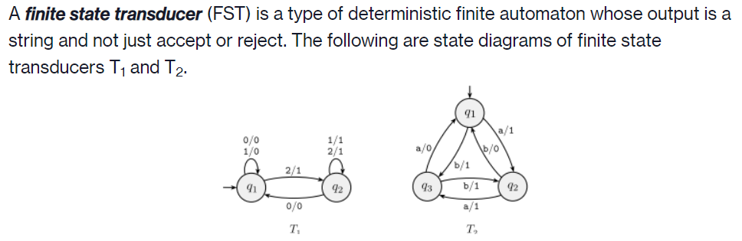
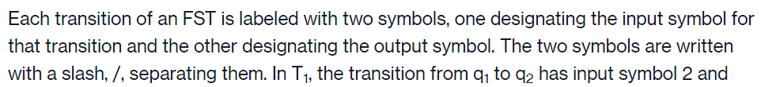
Regular languages (Applications): Finite State Transducers

Slide 20
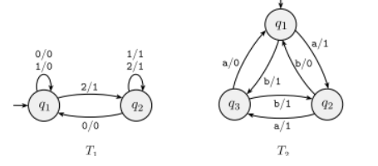
Regular languages (Applications): Finite State Transducers
When an FST computes on an input string w, it takes the input symbols w1⋅⋅⋅wn one by one and, starting at the start state, follows the transitions by matching the input labels with the sequence of symbols w1⋅⋅⋅wn=w.
Every time it goes along a transition, it outputs the corresponding output symbol.
For example, on input 2212011, machine T1 enters the sequence of states q1,q2,q2,q2,q2,q1,q1,q1 and produces output 1111000.
On input abbb, T2 outputs 1011.

Slide 21
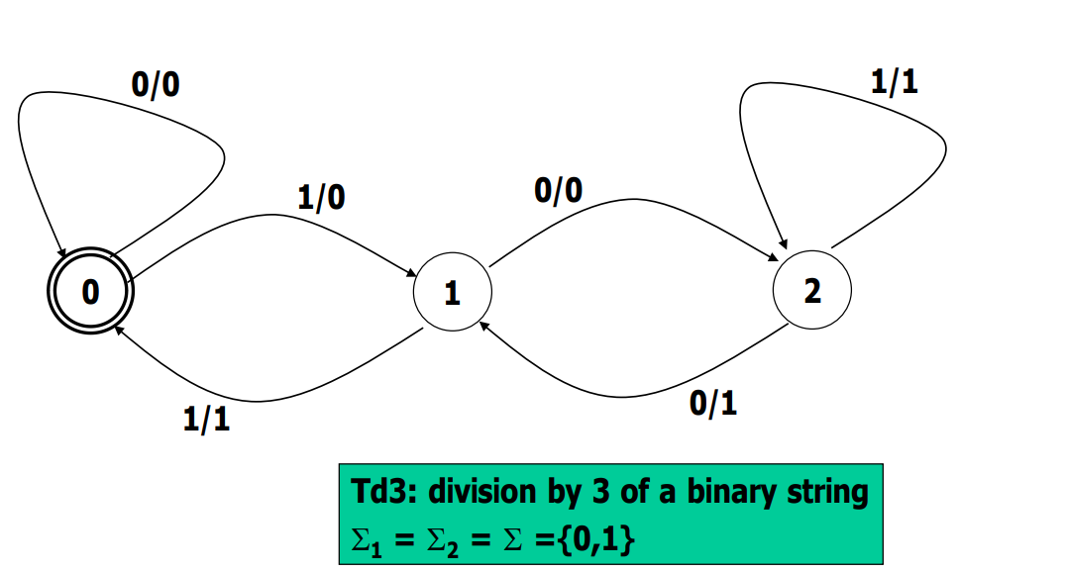
Regular languages (Applications): Finite State Transducers
1 | 1 | 1 | 1 1
0 | 1 | 0 | 1 0

Slide 22
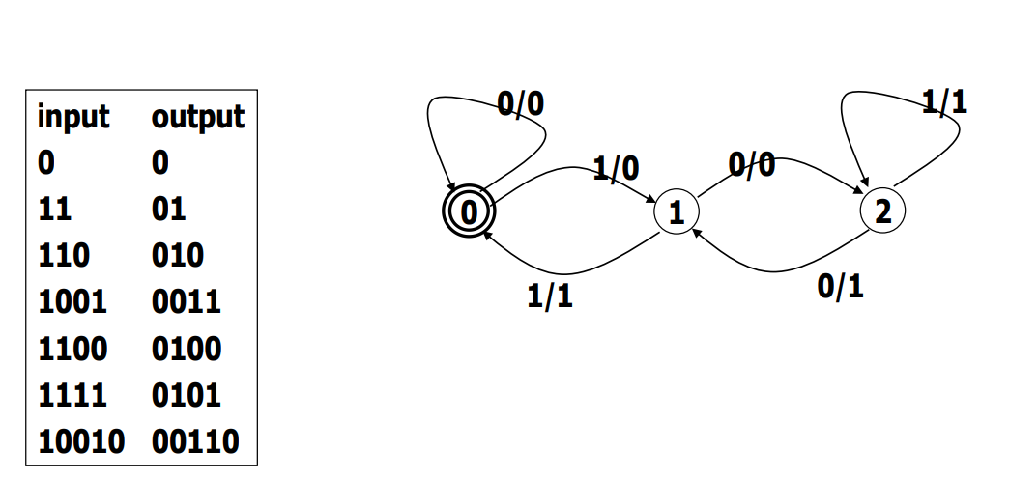
Regular languages (Applications): Finite State Transducers

Slide 23
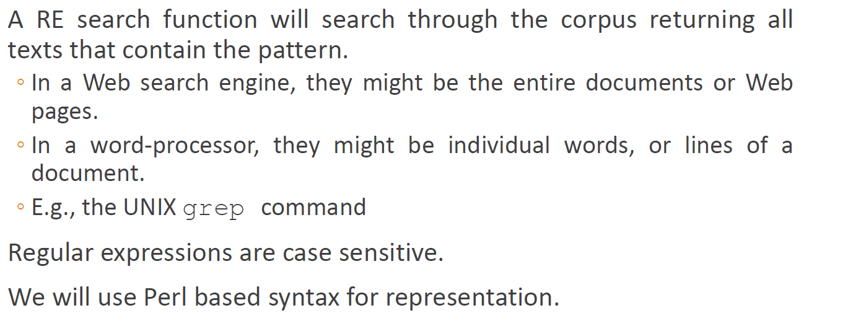
Regular languages (Applications)

Slide 24
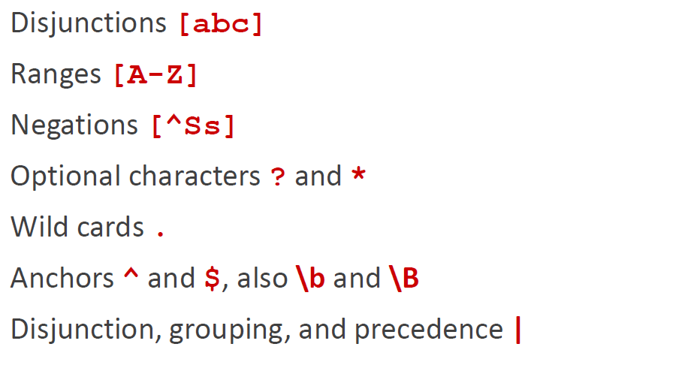
Regular languages (operations)

Slide 25
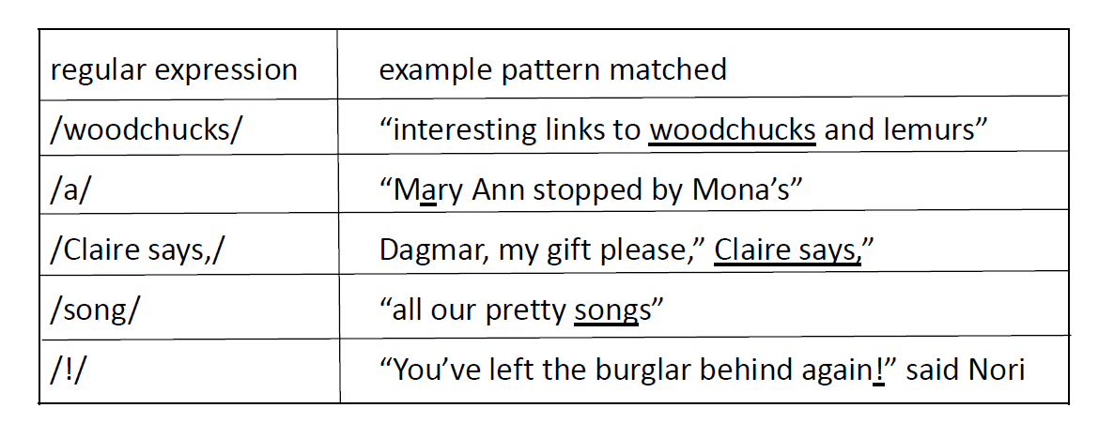
Regular Expression patterns

Slide 26
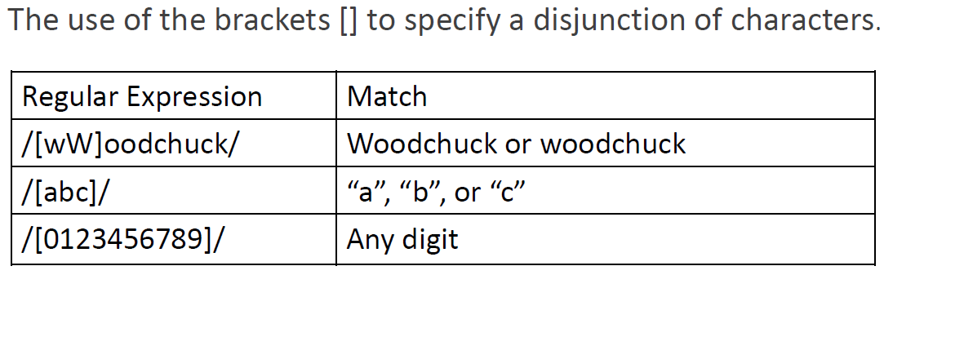
Regular Expression patterns

Slide 27
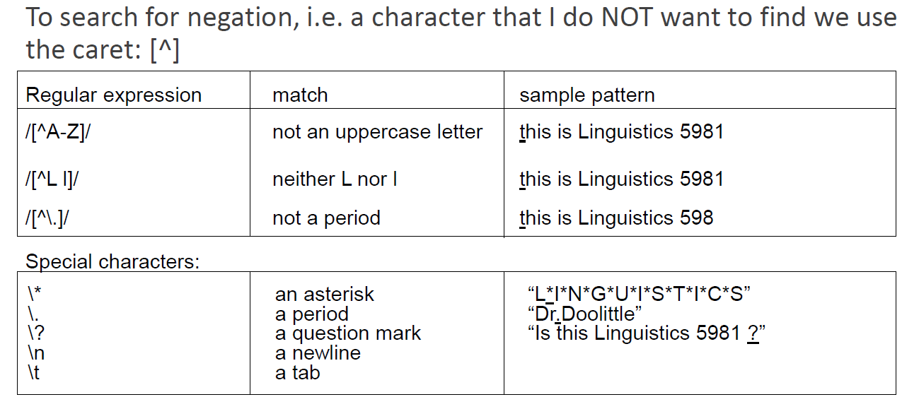
Regular Expression patterns

Slide 28
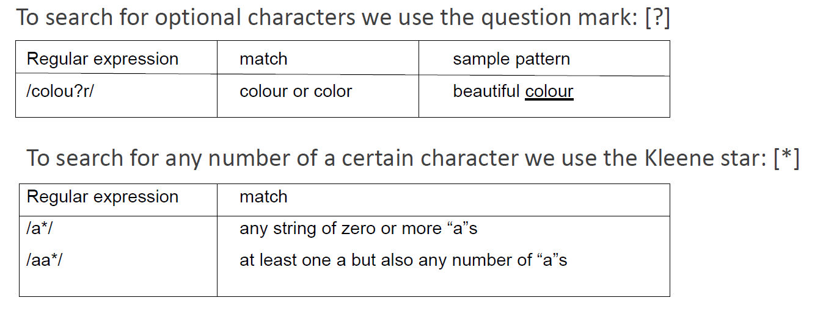
Regular Expression patterns

Slide 29
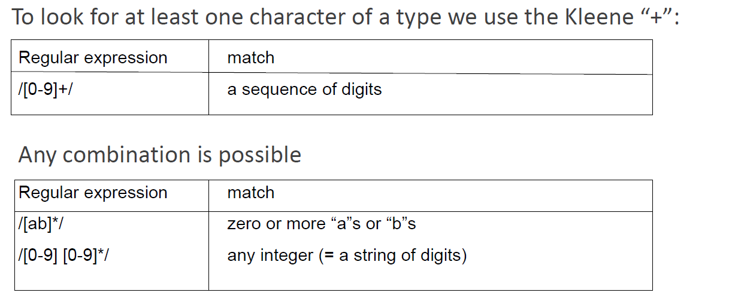
Regular Expression patterns

Slide 30
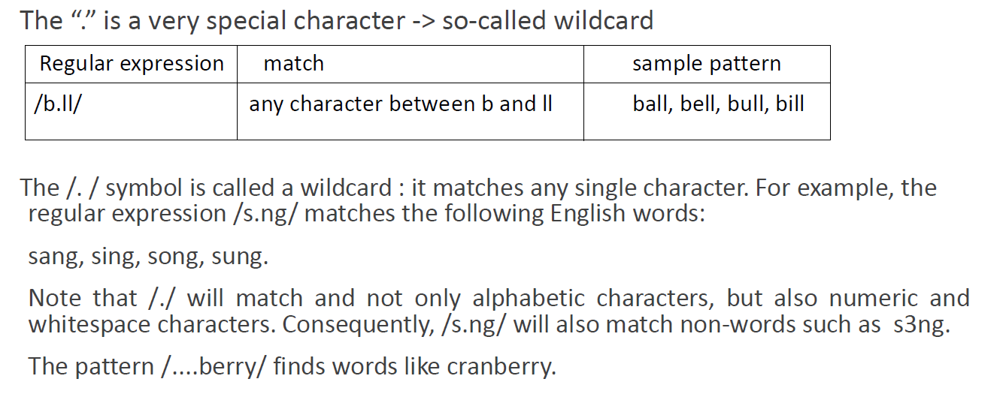
Regular Expression patterns

Slide 31
Regular Expression patterns

Slide 32
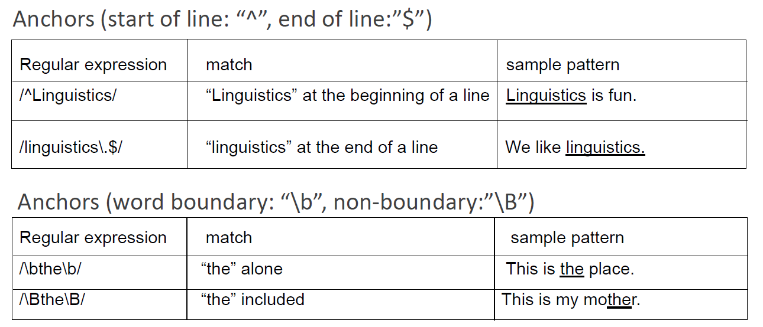
Regular Expression patterns

Slide 33
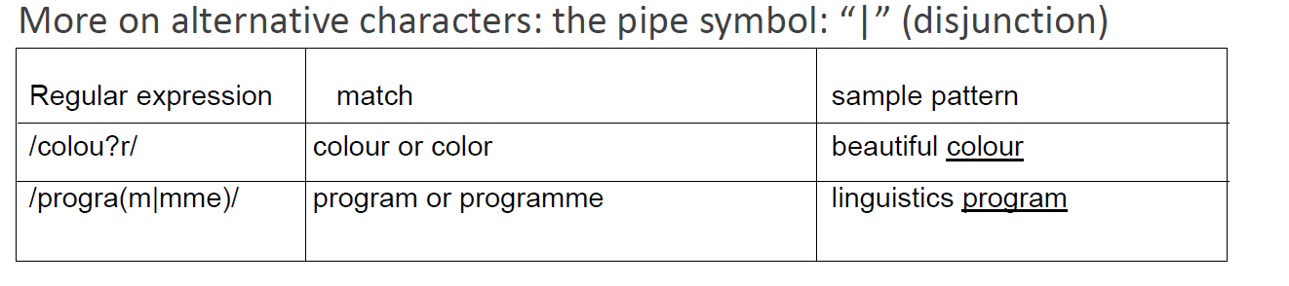
Regular Expression patterns

Slide 34
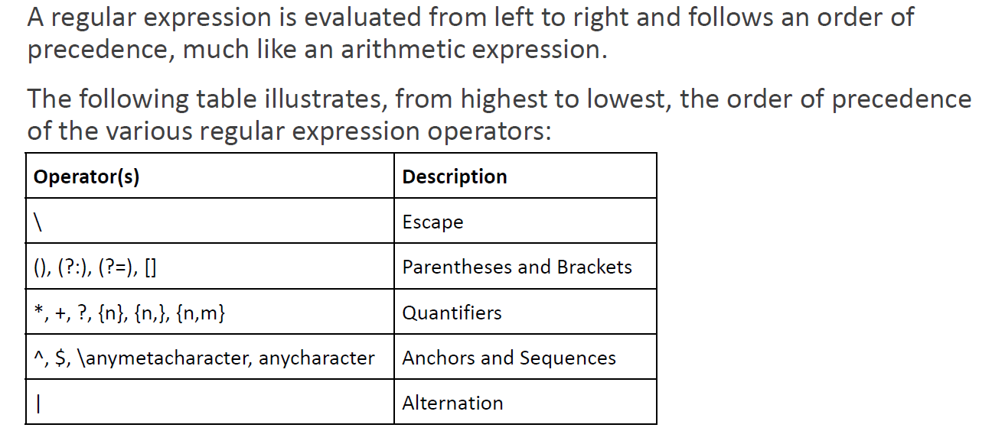
Operator precedence

Slide 35
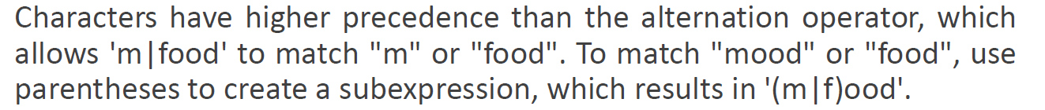
Operator precedence
Regular expressions are case sensitive; lower case /s/ is distinct from upper case /S/ (/s/ matches a lower case s but not an upper case S). This means that the pattern /woodchucks/ will not match the string Woodchucks.
We can solve this problem with the use of the square braces [ and ]. The string of characters inside the braces specifies a disjunction of characters to match.

Slide 36
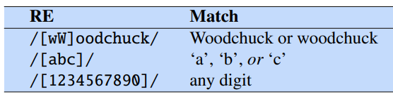
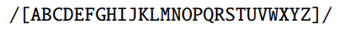
Operator precedence (Example)
The regular expression /[1234567890]/ specifies any single digit.
While such classes of characters as digits or letters are important building blocks in expressions, they can get awkward (e.g., it’s inconvenient to specify to mean “any capital letter”)

Slide 37
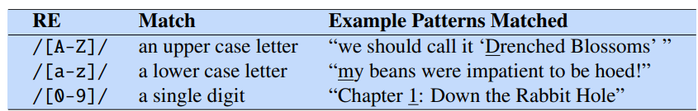
Operator precedence (Example)
In cases where there is a well-defined sequence associated with a set of characters, the brackets can be used with the dash (-) to specify range any one character in a range.
The pattern /[2-5]/ specifies any one of the characters 2, 3, 4, or 5. The pattern /[b-g]/ specifies one of the characters b, c, d, e, f, or g.

Slide 38
Operator precedence (Example)
One very important special character is the period (/./), a wildcard expression that matches any single character.

Slide 39
Operator precedence (Example)
Anchors are special characters that anchor regular expressions to particular places in a string.
The most common anchors are the caret ˆ and the dollar sign $.
The caret ˆ matches the start of a line.
The pattern /ˆThe/ matches the word The only at the start of a line.
Thus, the caret ˆ has three uses: to match the start of a line, to indicate a negation inside of square brackets, and just to mean a caret.
The dollar sign $ matches the end of a line.
So the pattern $ is a useful pattern for matching a space at the end of a line, and /ˆThe dog\.$/ matches a line that contains only the phrase The dog.

Slide 40
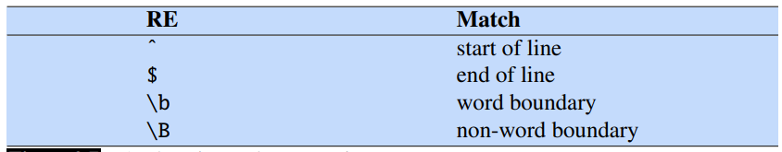
Operator precedence (Example)
There are also two other anchors: \b matches a word boundary, and \B matches a non-boundary.
Thus, /\bthe\b/ matches the word the but not the word other. More technically, a “word” for the purposes of a regular expression is defined as any sequence of digits, underscores, or letters; this is based on the definition of “words”
For example, /\b99\b/ will match the string 99 in There are 99 bottles of beer on the wall (because 99 follows a space) but not 99 in There are 299 bottles of beer on the wall (since 99 follows a number).

Slide 41
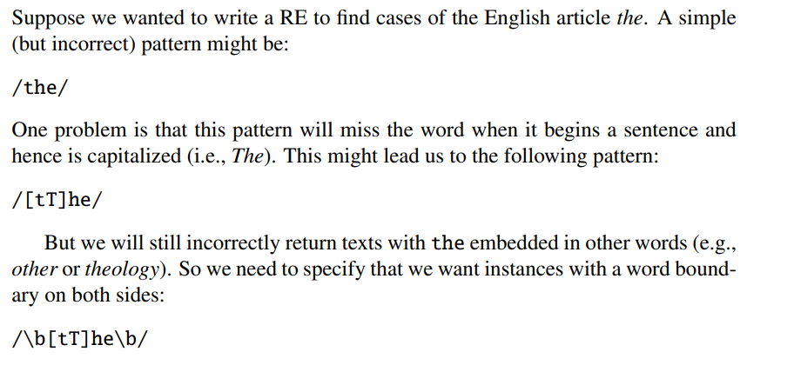
A Simple Example

Slide 42
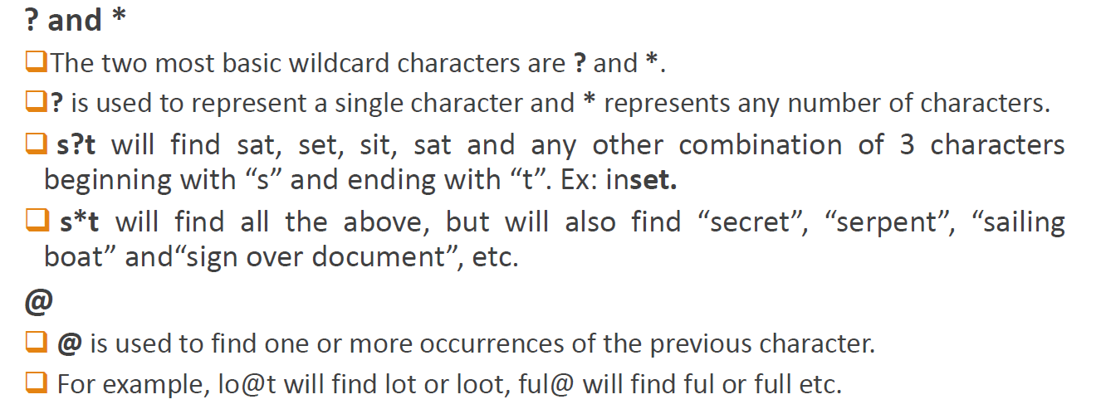
Regular Expressions in MS-Word

Slide 43
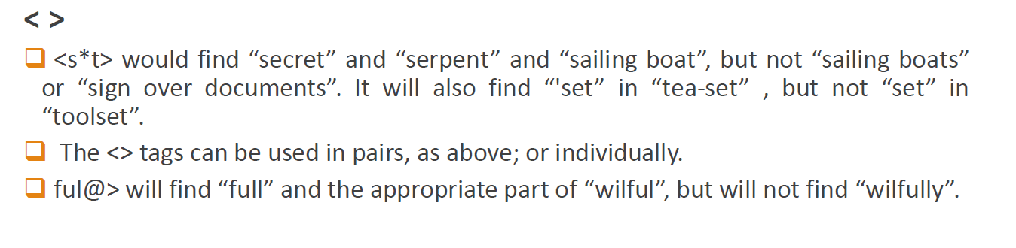
Regular Expressions in MS-Word

Slide 44
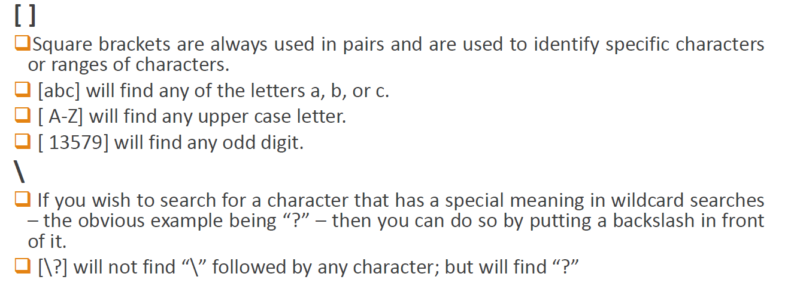
Regular Expressions in MS-Word

Slide 45
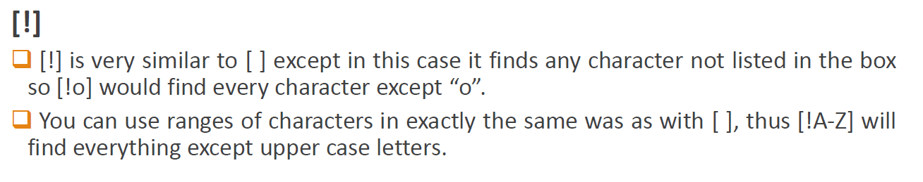
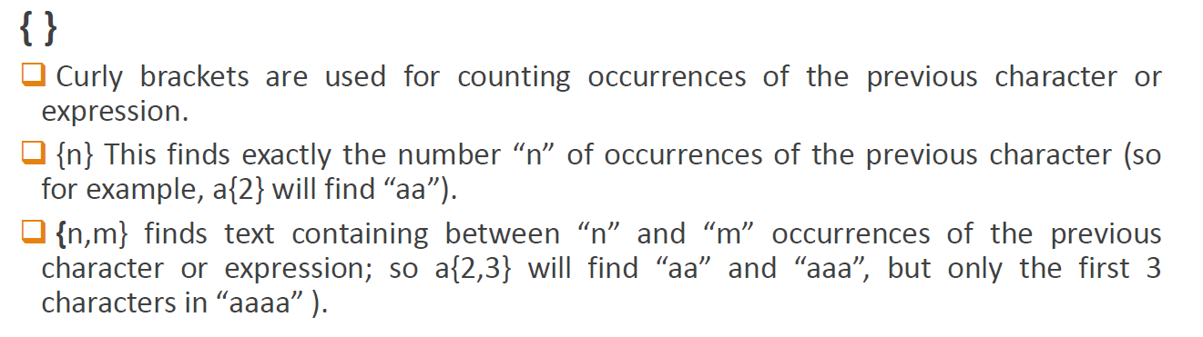
Regular Expressions in MS-Word

Slide 46
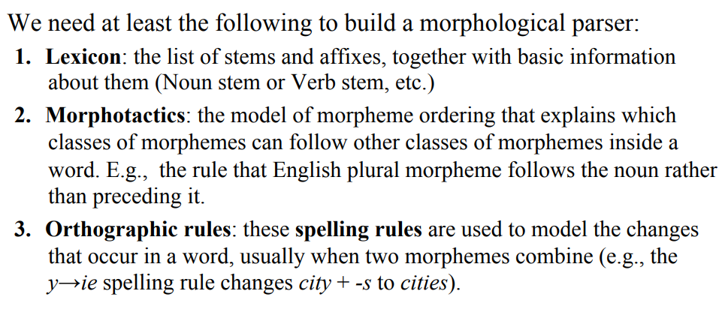
Finite-State Morphological Parsing
List of components in morphological parsing

Slide 47
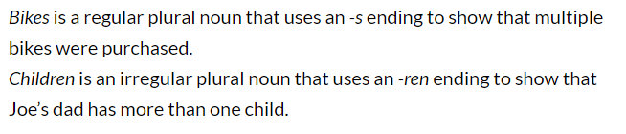
Finite-State Morphological Parsing
Commonly used keywords
Regular Noun: A regular noun can be made plural by simply adding -s or -es to the end of the word. For example, a regular noun like pickle becomes plural by adding an -s to the end of the word, creating the plural noun pickles.
Irregular plural noun: An irregular plural noun is a noun that becomes plural in a way other than adding -s or -es to the end. For example, an irregular noun like mouse changes into the plural noun mice.
Lexicon is a repository for words.

Slide 48
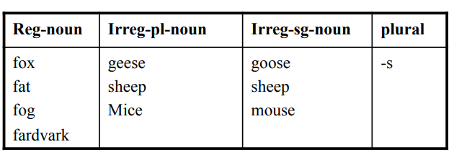
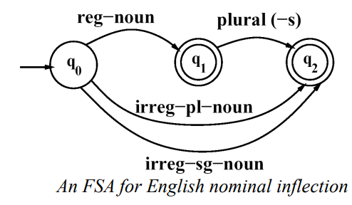
Singular to plural lexicon acceptance

Slide 49
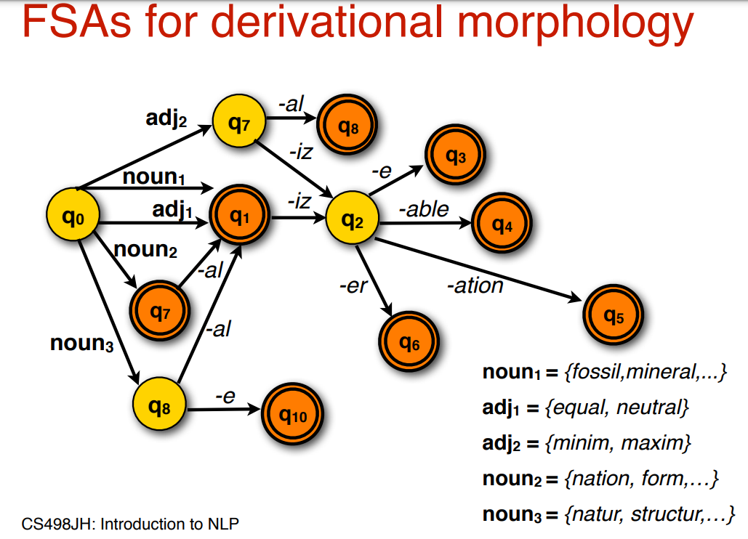
Singular to plural lexicon acceptance

Slide 50
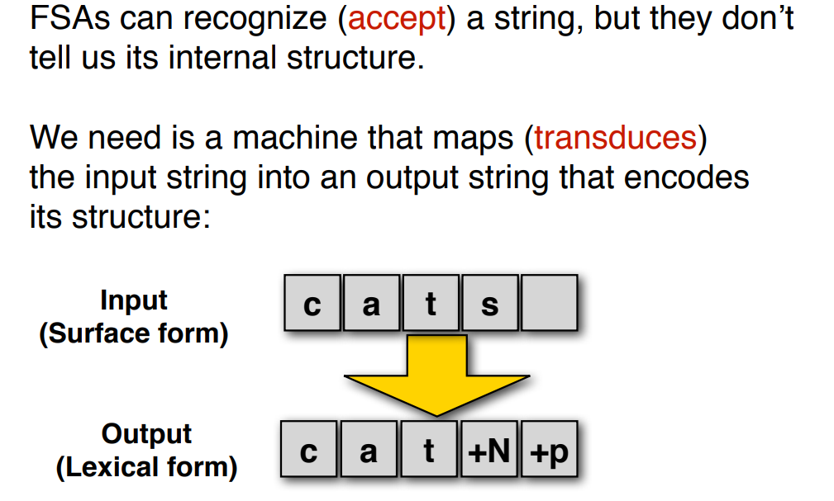
Morphological Parsing

Slide 51
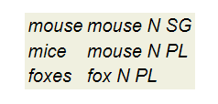
Objective of Morphological Parsing
The goal of morphological parsing is to find out what morphemes a given word is built from.
For example, a morphological parser should be able to tell us that the word cats is the plural form of the noun stem cat, and that the word mice is the plural form of the noun stem mouse.
So, given the string cats as input, a morphological parser should produce an output that looks similar to cat N PL.

Slide 52
Advantages of Parsing
Morphological parsing yields information that is useful in many NLP applications.
In parsing, e.g., it helps to know the agreement features of words.
Similarly, grammar checkers need to know agreement information to detect such mistakes.
But morphological information also helps spell checkers to decide whether something is a possible word or not, and in information retrieval it is used to search not only cats, if that's the user's input, but also for cat.

Slide 53
Algorithm
To get from the surface form of a word to its morphological analysis, we are going to proceed in two steps.
First, we are going to split the words up into its possible components.
So, we will make cat + s out of cats, using + to indicate morpheme boundaries.
In this step, we will also take spelling rules into account, so that there are two possible ways of splitting up foxes, namely foxe + s and fox + s.
The first one assumes that foxe is a stem and s the suffix, while the second one assumes that the stem is fox and that the e has been introduced due to the spelling rule that we saw above.

Slide 54
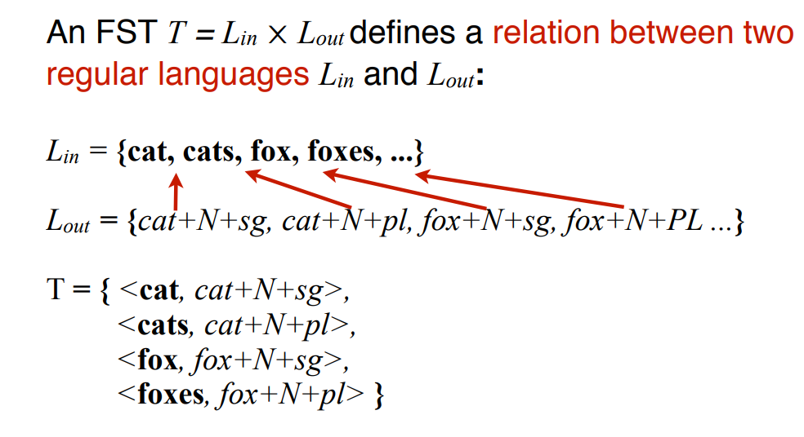
Recognition vs. Analysis
C | A | T | Epsilon
C:C
A:A
T:T
C | A | T | ES

Slide 55
Recognition vs. Analysis
In the second step, we will use a lexicon of stems and affixes to look up the categories of the stems and the meaning of the affixes.
So, cat + s will get mapped to cat NP PL, and fox + s to fox N PL.
We will also find out now that foxe is not a legal stem. This tells us that splitting foxes into foxe + s was actually an incorrect way of splitting foxes, which should be discarded.
But note that for the word houses splitting it into house + s is correct.

Slide 56
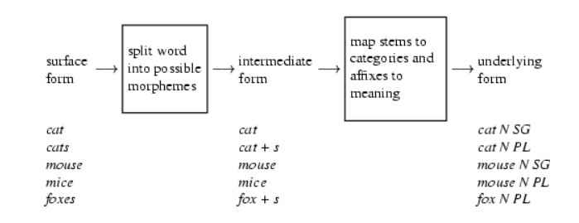
Recognition vs. Analysis
Here is a picture illustrating the two steps of our morphological parser with some examples.

Slide 57
Designing Transducer for Parsing
We will now build two transducers: one to do the mapping from the surface form to the intermediate form and the other one to do the mapping from the intermediate form to the underlying form.
Surface to the Intermediate Form
Intermediate Form to the Morphological Structure

Slide 58
Surface to the Intermediate Form
Now, we want to take the intermediate form that we produced in the previous section and map it to the underlying form.
The input that this transducer has to accept is of one of the following forms:
regular noun stem, e.g. cat
regular noun stem + s, e.g. cat + s
singular irregular noun stem, e.g. mouse
plural irregular noun stem, e.g. mice

Slide 59
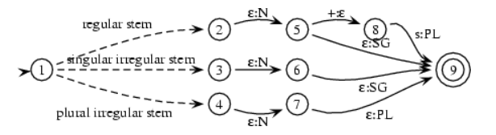
Surface to the Intermediate Form
In the first case, the transducer has to map all symbols of the stem to themselves and then output N and SG.
In the second case, it maps all symbols of the stem to themselves, but then outputs N and replaces PL with s.
In the third case, it does the same as in the first case.
Finally, in the fourth case, the transducer should map the irregular plural noun stem to the corresponding singular stem (e.g. mice to mouse) and then it should add N and PL.
So, the general structure of this transducer looks like this:

Slide 60
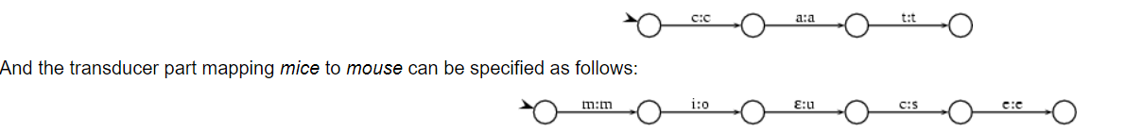
Surface to the Intermediate Form
What still needs to be specified is how exactly the parts between state 1 and states 2,3, and 4 respectively look like.
Here, we need to recognize noun stems and decide whether they are regular or not. We do this be encoding a lexicon in the following way.
The transducer part that recognizes cat, for instance, looks like this:
Plugging these (partial) transducers into the transducer given above we get a transducer that checks that input has the right form and adds category and numerus information.

Slide 61

State Switching in parsing
Source: https://cs.union.edu/~striegnk/courses/nlp-with-prolog/html/node19.html

Slide 62

Introduction to Stemming
Stemming is the process of producing morphological variants of a root/base word.
Stemming programs are commonly referred to as stemming algorithms or stemmers.
A stemming algorithm reduces the words “chocolates”, “chocolatey”, “choco” to the root word, “chocolate” and “retrieval”, “retrieved”, “retrieves” reduce to the stem “retrieve”.
Stemming is an important part of the pipelining process in Natural language processing.
The input to the stemmer is tokenized words. How do we get these tokenized words? Well, tokenization involves breaking down the document into different words.

Slide 63

Algorithms in Stemming
The Porter stemming algorithm (or ‘Porter stemmer’) is a process for removing the commoner morphological and inflexional endings from words in English.
Its main use is as part of a term normalisation process that is usually done when setting up Information Retrieval systems. For example:

Slide 64
Porter Algorithm
The Porter stemming algorithm (or ‘Porter stemmer’) is a process for removing the commoner morphological and inflexional endings from words in English.
Its main use is as part of a term normalisation process that is usually done when setting up Information Retrieval systems. For example:

Slide 65

Porter Algorithm

Slide 66


Slide 67


Slide 68






Slide 69



Slide 70


Slide 71


Slide 72
Phonetic transcription
Phonetic transcription (also known as phonetic script or phonetic notation) is the visual representation of speech sounds (or phones) by means of symbols.
The most common type of phonetic transcription uses a phonetic alphabet, such as the International Phonetic Alphabet.
The International Phonetic Alphabet (IPA) is an alphabetic system of phonetic notation based primarily on the Latin script.
IPA symbols are composed of one or more elements of two basic types, letters and diacritics. For example, the sound of the English letter ⟨t⟩ may be transcribed in IPA with a single letter, [t], or with a letter plus diacritics, [t̺ʰ], depending on how precise one wishes to be.[note 1] Slashes are used to signal phonemic transcription; thus /t/ is more abstract than either [t̺ʰ] or [t] and might refer to either, depending on the context and language.

Slide 73


Phonetic transcription (Greek Phonetics)

Slide 74
Allophonic transcription
A transcription which includes some allophonic detail but is closely linked to the phonemic structure of an utterance is called an allophonic transcription.
In English the t sounds in the words “hit,” “tip,” and “little” are allophones; phonemically they are considered to be the same sound although they are different phonetically in terms of aspiration, voicing, and point of articulation.
The /l/ sound is pronounced differently in 'love' and in 'wool'. These two words contain allophones of the phoneme /l/.

Slide 75


Phonemes and Allophones

Slide 76

Activity: Environment for Aspiration

Slide 77

Phonological Processes

Slide 78

Phonological Processes

